Slide 1
RTX CORPORATION
NYSE: RTX
CURRENT PRICE
TARGET PRICE
RECOMMENDATION
$198.09
$208.67
HOLD
The World's Largest Aerospace & Defense Company
February 2026
Presented by: JOE MARFISI

Slide 2
Business Description
RTX Corporation — Split into 3 sections
Raytheon
Pratt & Whitney
Collins Aerospace
Defense Segment
Jet Engines
Avionics Systems
Produces Patriot missile defensive systems, advanced radar systems, and Tomahawk Cruise missiles
Manufacture jet engines: GTF engine and F135 engine
Specialize in Avionic systems – tells pilots where they are and what’s around them
These are found in every plane — commercial and military
RTX Corporation (NYSE: RTX) | February 2026 | Joe Marfisi
Notes:
The Company RTX Corporation — the largest aerospace and defense company in the world with $88.6 billion in revenue Born from the 2020 merger of United Technologies Corporation and Raytheon Company — two giants combining into one UTC brought Pratt &amp; Whitney and Collins Aerospace — the commercial aviation powerhouses Raytheon brought the defense muscle — missiles, radar, and electronic warfare The result is something no competitor can replicate — equal parts commercial aviation and defense in one company Raytheon The pure defense engine of RTX Makes the weapons the world is buying right now — Patriot missile systems, Tomahawk cruise missiles, NASAMS, advanced radar Deployed actively in Ukraine, the Middle East, and across NATO Europe Book to bill ratio of 2.27 — for every dollar shipped, $2.27 in new orders came in Essentially sold out for years Pratt &amp; Whitney Powers the world's most popular commercial jet — the Airbus A320neo Exclusive engine supplier for every F-35 ever built — no alternatives exist 15,000+ engines in service globally creating decades of locked in aftermarket revenue Real business model — sell the engine once, collect high margin service revenue for 30 years Collins Aerospace The quiet backbone of global aviation Avionics, landing gear, power systems, cabin interiors — if it's inside an aircraft Collins probably made it Embedded in virtually every commercial and military platform flying today Nearly impossible to displace without redesigning the entire aircraft around it Timeline:

Slide 3
Business Description – Revenue Split
Collins Aerospace
34.0%
$28.28B
$80.7B
Total Revenue
Pratt & Whitney
33.8%
$28.07B
Raytheon
32.2%
$26.71B
RTX Corporation (NYSE: RTX) | February 2026 | Joe Marfisi
Notes:
Defense and commercial aviation contracts aren't one-time sales — they're multi-year relationships that generate revenue long after the initial deal is signed Defense contracts typically run 3 to 7 years — on February 3rd RTX signed a deal with the Pentagon to boost missile production for up to 7 years . In 2025 they secured a Patriot missile defense contract spanning 20 years RTX and its competitors deliberately bid at razor thin margins just to win the contract — the real profit comes from the years of service, parts, and upgrades that follow. The bid is the door. The aftermarket is the business This model applies equally to commercial aviation — the FAA requires airlines to maintain their engines on a strict schedule, and performing that maintenance requires certifications that only a handful of companies in the world hold RTX doesn't just sell airlines an engine — they sell them the only FAA certified blade that fits it. No certification, no alternative, no negotiation on price 15,000+ Pratt &amp; Whitney engines in service globally — each one a locked-in revenue stream feeding parts, maintenance, and overhaul revenue back to RTX for decades The initial contract is how RTX gets in the door. The next 30 years is how RTX gets paid

Slide 4
Current News
Geopolitical Climate
Iran / US
Ukraine / NATO
Trump / Global Outlook
Iran passed 200% military budget increase to $46B following domestic unrest
U.S. assembled largest Middle East naval armada since 2003 Iraq invasion
Patriot missiles (RTX made) are currently being used against Russian ballistic missiles
Defense items donated are legally required to be replenished to NATO
Trump proposed $1.5 trillion defense budget for 2027 – largest defense spending proposal in US history
Trump has put pressure on RTX paying out dividends and issuing stock buybacks
Spain just signed $1.7B for four Patriot fire units – December 2025
RTX Corporation (NYSE: RTX) | February 2026 | Joe Marfisi
Notes:
Iran / Middle East The Middle East is in the early stages of its rearmament cycle — the biggest procurement surge is still ahead RTX doesn't supply Iran — it supplies everyone watching Iran nervously from next door The Israel-Palestine conflict involved conventional weapons. A direct confrontation with Iran is a completely different threat level — both sides bring sophisticated missile systems, air defense, and electronic warfare into play That escalation in sophistication is exactly what drives allied countries to upgrade their own defense capabilities — and RTX is who they call Trump / Global Outlook Trump publicly pressured defense companies by name last month — RTX was specifically called out for paying dividends and issuing stock buybacks instead of reinvesting in manufacturing capacity CEO Chris Calio pushed back — RTX has paid shareholders quarterly for decades and views that commitment as non-negotiable The silver lining is buried in the criticism — Trump isn't upset because demand is weak. He's upset because demand is so overwhelming that every dollar going to shareholders is a dollar not building more missiles We are caught directly in this argument — our fund collects the dividends. We benefit from the buybacks through fewer shares outstanding. Institutions like BlackRock and Vanguard benefit most but so do we The more important story is the neighboring countries — Europe is actively trying to make their defense systems more independent Germany increased defense spending 28% made a 3 billion deal with Raytheon for SM6 and Sm-2 missiles, Poland 31%, and RTX just signed a $1.7 billion Patriot contract with Spain last week RTX won't make its biggest sales to the countries at war — it will make them to every country watching that war and deciding they aren't prepared enough

Slide 5



Management Overview
Phil Jasper
Troy Brunk
Christopher Calio
President of Raytheon sector
President of Collins Aerospace
CEO
Previously President of Collins Aerospace
33 years of industry experience
Has military background
30 years of experience
Been with UTC since 2005
Former COO
RTX Corporation (NYSE: RTX) | February 2026 | Joe Marfisi

Slide 6
Porter’s Five Forces
Threat of New Entrants
LOW
Need standing relationships with government
Certifications required
Threat of Substitute Products
Competitive Rivalries
LOW TO MODERATE
RTX
Competitive Position
HIGH
No viable substitutes exist for core products like the F135 engine or Patriot missile defense systems
RTX is proactively investing in AI through ventures like EpiSci and HawkEye 360 to stay ahead of technological disruption
Competes with Lockheed Martin, Northrop Grumman & Boeing
Bargaining Power of Buyers
Bargaining Power of Suppliers
MODERATE
MODERATE TO HIGH
U.S. government is the largest customer but has limited alternatives
Airlines face high switching costs
Long term contracts give RTX leverage
Rare Earth materials can create pricing pressure
RTX Corporation (NYSE: RTX) | February 2026 | Joe Marfisi

Slide 7
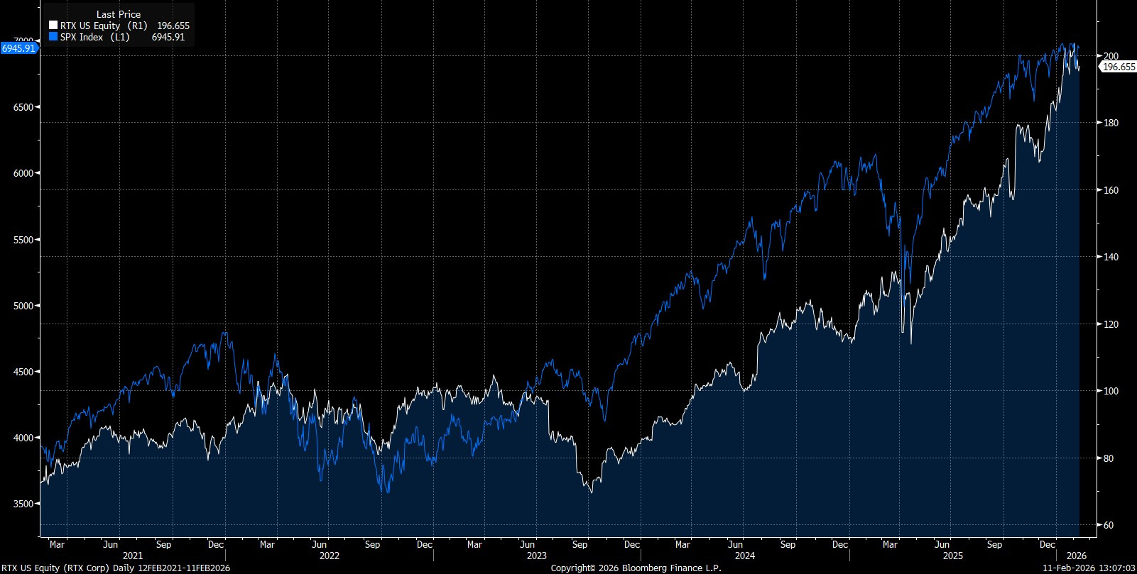
RTX vs. S&P 500
CURRENT PRICE
$198.09
TARGET PRICE
$208.67
BETA
0.43
WACC
7.67%
Source: Bloomberg
RTX Corporation (NYSE: RTX) | February 2026 | Joe Marfisi
Notes:
In the past year its closed the gap with the S&amp;P. Important to note this industry is very reactive to deals – deals are binary you get them or you don&#x2019;t.

Slide 8
DCF – WACC Assumptions
WACC
Share Price
$175.63
Key Observations
Diluted Shares Outstanding (B)
1.340
Industry standard is 7–8%
Low raw beta because of locked in revenue
Cost of Debt
4.50%
Tax Rate
21.0%
After-tax Cost of Debt
3.56%
Cost of Equity
8.25%
Risk-free Rate
4.10%
Market Risk Premium
5.40%
Beta
0.43
Adjusted Beta
0.77
Total Debt ($B)
43.500
Total Equity ($B)
235.344
Total Capital ($B)
278.844
Debt Weighting
15.60%
Equity Weighting
84.40%
WACC =
7.67%
RTX Corporation (NYSE: RTX) | February 2026 | Joe Marfisi

Slide 9
DCF – Major Assumptions
Balance Sheet & Capital Trajectory (2021 → 2030)
Capital expenditures grow from $2.0B in 2021 to a projected $3.9B by 2030 (projected as % of revenue)
Inventories nearly double from $9.4B to $18.3B from 2021 to 2030
Accounts payable more than doubles from $21B to $42.4B
Capex, Inventories, and Accounts payable → % of revenue
Bottom line: RTX is in active production ramp mode absorbing significant capital upfront.
TAX RATE
LONG-TERM GROWTH
REVENUE GROWTH
EBIT MARGIN
21%
3.5%
5.8%
11.4%
Revenue Growth and EBIT Margin both found with geometric average
RTX Corporation (NYSE: RTX) | February 2026 | Joe Marfisi
Notes:
Rising inventories plus rising capex plus rising payables all tell the same story — RTX is in active production ramp mode. The balance sheet is absorbing significant working capital to fund that ramp. Rising inventory reflects RTX&#x2019;s production map you need to buy the materials and build components before shipping off the Patriot missles A 3.5% long term growth rate reflects the blended structural growth of both end markets rather than anchoring purely to U.S. GDP which would understate RTX's international exposure and the permanent upward reset in defense budgets we're currently witnessing globally.&#x201D; The 3.8% capex forecast is geomean of historical data. I decided to use empirical data instead of speculative assumptions when in doubt I default to what the company has actually demonstrated rather than what I think should happen

Slide 10
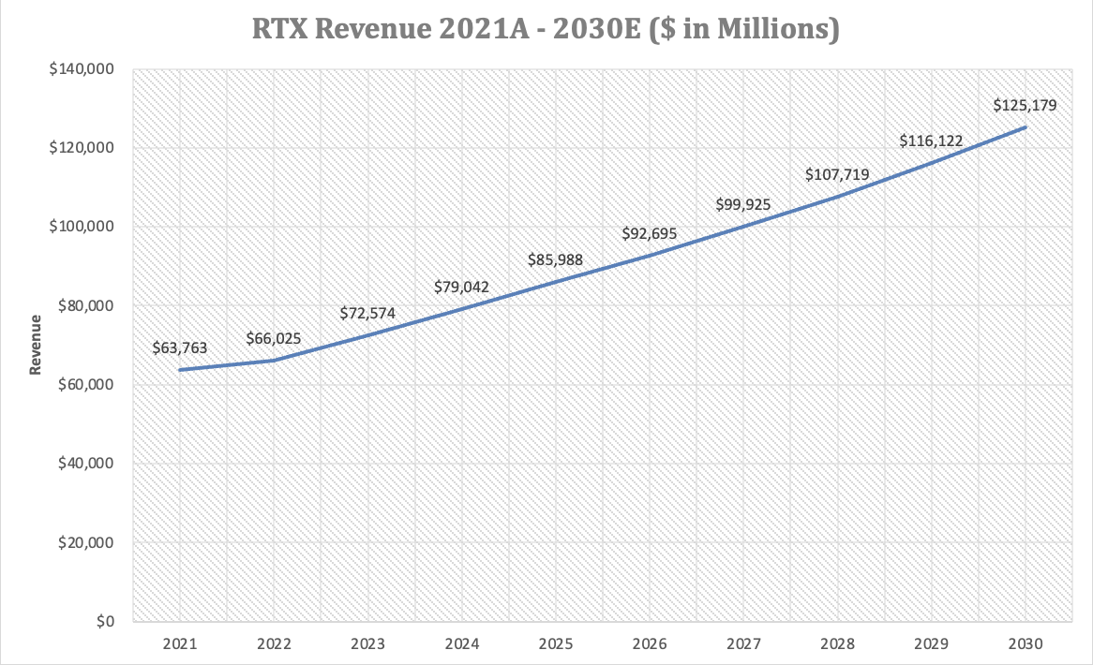
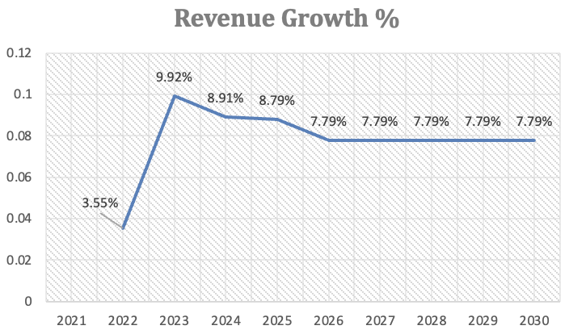
Revenue / Revenue Growth
Source: Company filings, model output
RTX Corporation (NYSE: RTX) | February 2026 | Joe Marfisi
Notes:
As I mentioned previously mentioned, RTX relies on contracts and backlogs. Because of this RTX&#x2019;s future revenue is pretty much set in stone. Roughly 85% of Raytheon&#x2019;s 2026 sales were booked early this year. For my revenue growth assumption I did the geometric mean of the past the past five years. And then I also double checked and made sure that my assumptions were close to the predicted sales reported by RTX. Note that the revenue growth jumps from 3.55% to 9.92% this was due to a contaminated metal crisis with the manufacture of GTF engines which is a part of the Pratt &amp; Whitney sector. This caused hundreds of commercial aircrafts to be grounded, and as I previously touched on, RTX makes their revenue through maintenance, so when the aircrafts aren&#x2019;t being used then its going to affect the aftermarket revenue. 2.8 Billion in cumulative charges This was a one time event and actually caused RTX to increase their inspection. Thought it was better to include it than to speculate – makes DCF target price more conservative

Slide 11
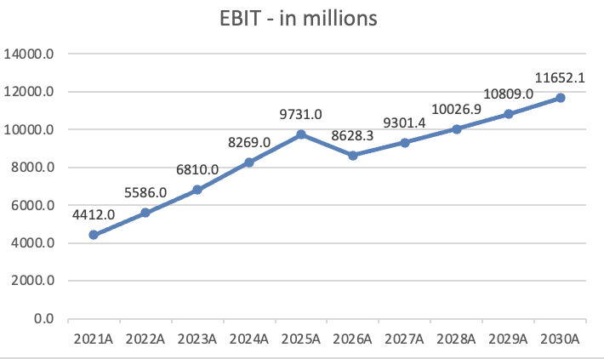
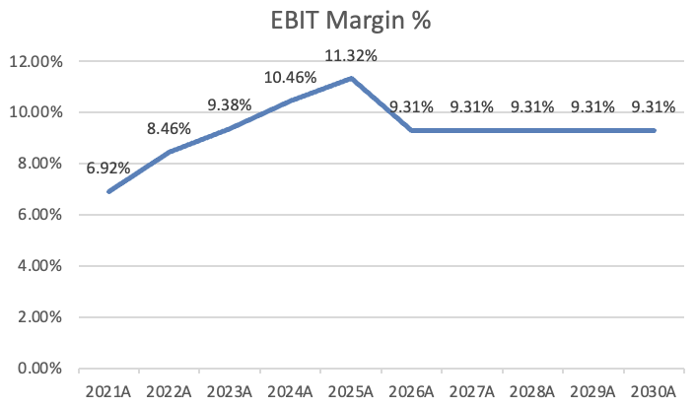
EBIT Margin
Source: Company filings, model output
RTX Corporation (NYSE: RTX) | February 2026 | Joe Marfisi
Notes:
For my EBIT you can see that for my first forecasted year there&#x2019;s a dip and then after that a steady incline, this is because I took the geometric mean of the past five years. This included the Powder crisis so this is going to make my sensitivity analysis more conservative.

Slide 12
Sensitivity Analysis
Revenue Growth (ST Growth)
EBIT Margin
RTX Corporation (NYSE: RTX) | February 2026 | Joe Marfisi
Notes:
Must remember RTX&#x2019;s backlog anchor in on the 7.79%. Then we just focus on the EBIT margin. Our base case was 9.31% but this was conservative when considering the manufacturing crisis. The headwinds will resolve in the next 12 months. The powder metal compensation payments end by late 2026. That will be $700 million in charges paid out that will stop paying out to airlines. That money goes straight to profit – no new revenue or customers needed. Pratt&#x2019;s GTF aftermarket just began so every year those 15,000 engines will need to be serviced.

Slide 13
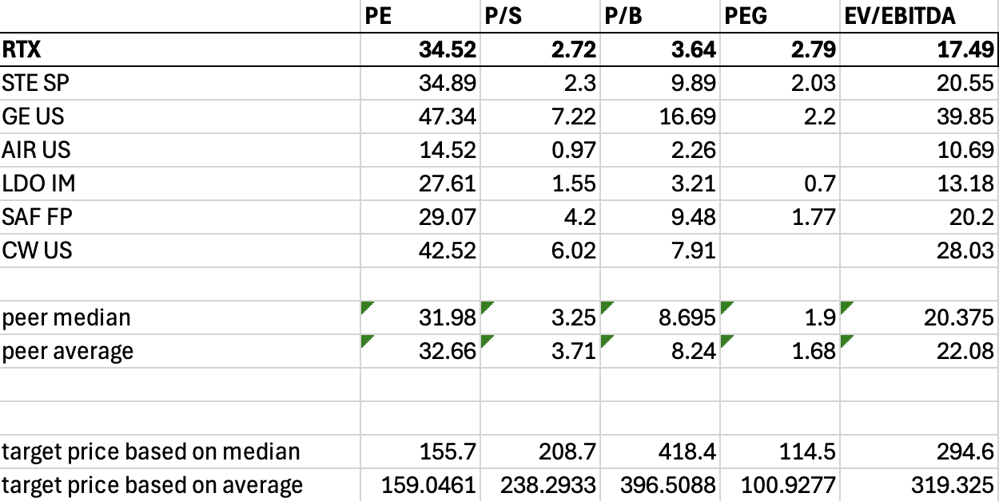
Relative Valuation
RTX Corporation (NYSE: RTX) | February 2026 | Joe Marfisi
Source: Bloomberg, company filings
Notes:
Its difficult to compare RTX with other companies given its diversified portfolio. Got some Global competitors, international aerospace commercial and defense companies. Didn&#x2019;t include Lockeed and Northrop because they were are pure defense contract companies. PE/PEG relationship catches the eye but as I said the powder metal charges are eating into the earnings The Merger Effect When RTX merged UTC and Raytheon in 2020 it was an all-stock deal worth roughly $121 billion. That transaction created an enormous amount of goodwill and intangible assets on the balance sheet — essentially the premium paid above the book value of Raytheon's hard assets. Goodwill alone on RTX's balance sheet is approximately $50+ billion. Goodwill inflates book value. A higher book value denominator means a lower P/B ratio even at the same stock price. RTX's book value is artificially large because of the merger accounting, which makes P/B look deceptively low.

Slide 14
Summary
How did I get the target price? $208.67
EV / EBITDA — 40%
DCF — 60%
BLENDED TARGET
Relative valuation
Intrinsic valuation
40 / 60 weighting
RECOMMENDATION
HOLD
Target $208.67
Current $198.09
$294.60
$151.39
$208.67
More to story
Why Hold?
Diversified revenue streams
Headwinds will resolve
15,000 Pratt engines globally – 19 countries operating Patriot systems
RTX Corporation (NYSE: RTX) | February 2026 | Joe Marfisi
Notes:
Aerospace and defense is capital intensive — EV/EBITDA is the cleaner multiple because it strips out depreciation, amortization, and merger accounting noise that distorts every other metric for RTX DCF is weighted more heavily at 60% because RTX's $268 billion backlog removes the biggest source of DCF uncertainty — revenue is essentially already known for the next three years, making the model unusually reliable No peer multiple can fully capture what RTX is — the only major company in the world that benefits from two completely opposite economic environments simultaneously Commercial aviation is in full post-COVID recovery while the world is simultaneously in the biggest rearmament wave since the Cold War — both cycles firing at once is historically rare and no comparable company is positioned to capture both Important to hold a defense company, even if Iran and US deescalate, RTX is still diversified

Slide 15
Thank You
RTX Corporation (NYSE: RTX) | Recommendation: HOLD | Target: $208.67
Joe Marfisi | February 2026
University of Nebraska–Lincoln | Finance, College of Business

